Slide 1
Counting sort

Slide 2
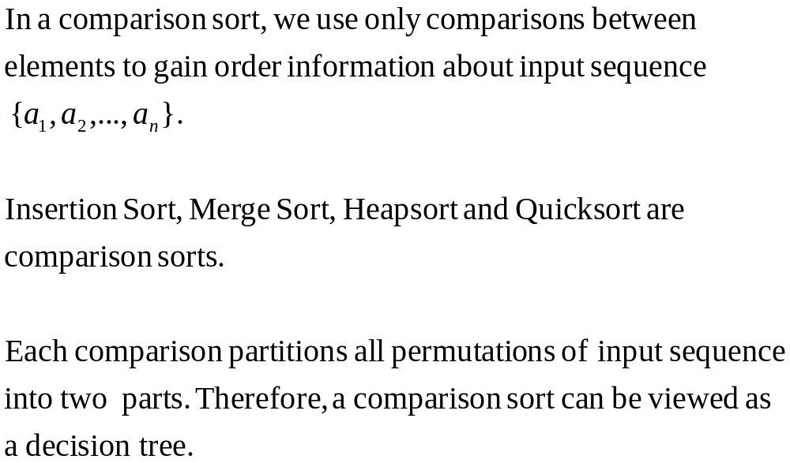
Comparison Sort

Slide 3



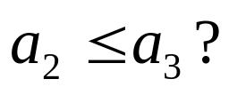








Decision Tree

Slide 4
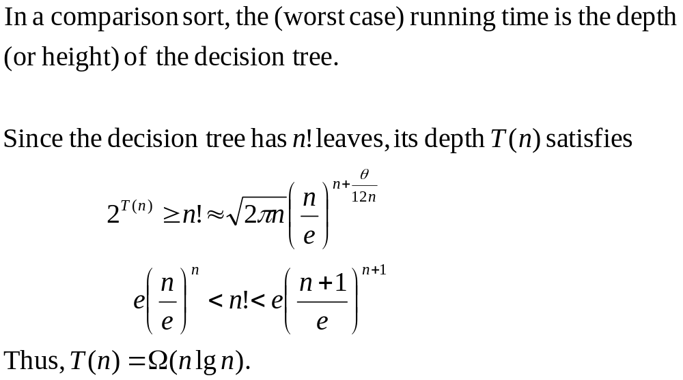
Running Time
Is there a faster sorting of other type?

Slide 5
CountingSort
Counting sort is a sorting technique based on keys between a specific range.
It works by counting the number of objects having distinct key values (kind of hashing).
Then do some arithmetic to calculate the position of each object in the output sequence.

Slide 6
CountingSort
Characteristics of counting sort:
Counting sort makes assumptions about the data, for example, it assumes that values are going to be in the range of 0 to 10 or 10 – 99 etc, Some other assumptions counting sort makes are input data will be all real numbers.
Like other algorithms this sorting algorithm is not a comparison-based algorithm, it hashes the value in a temporary count array and uses them for sorting.
It uses a temporary array making it a non In Place algorithm.

Slide 7
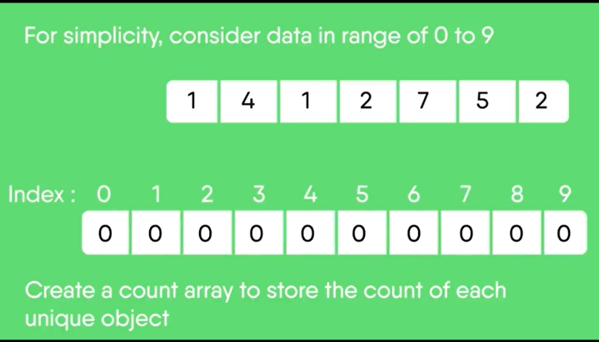

Slide 8
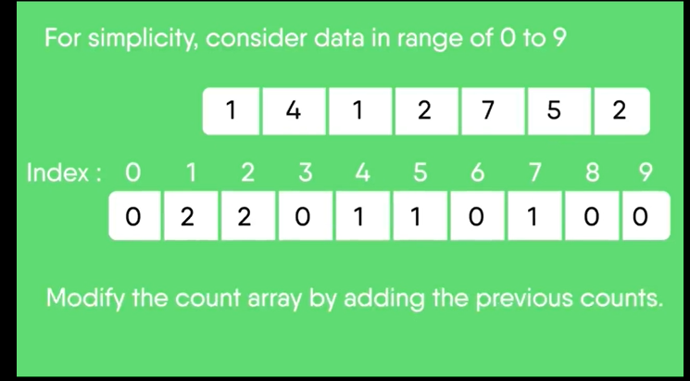
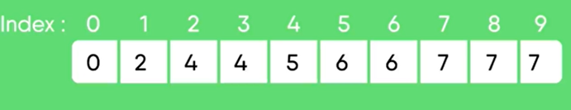

Slide 9
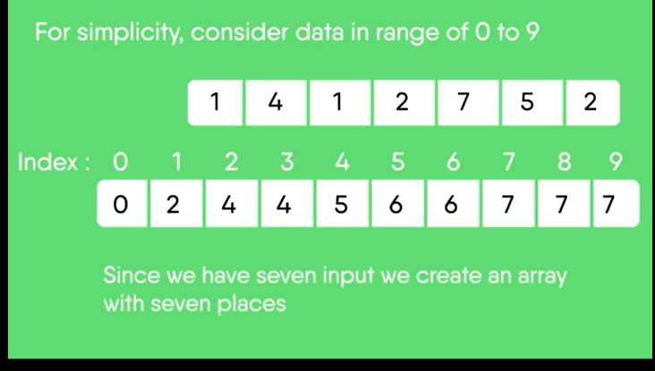

Slide 10
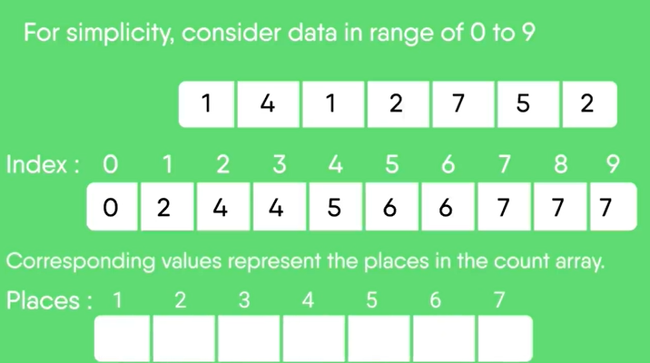

Slide 11
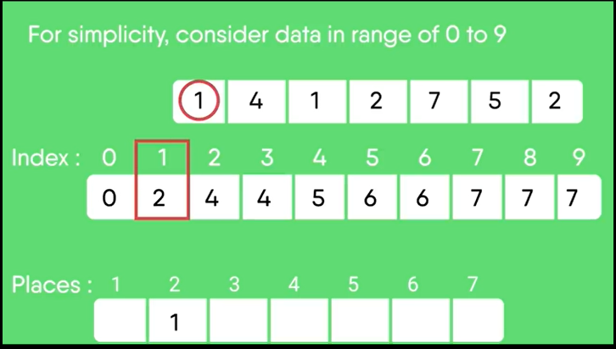

Slide 12
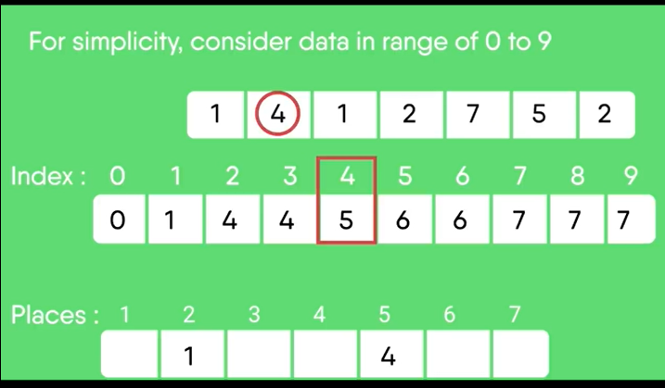

Slide 13
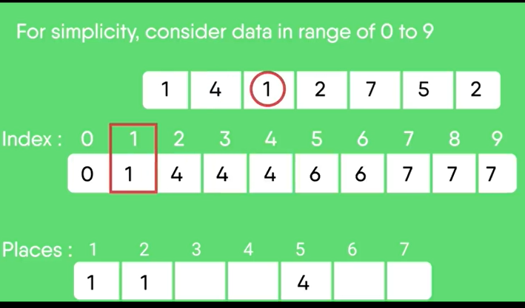

Slide 14
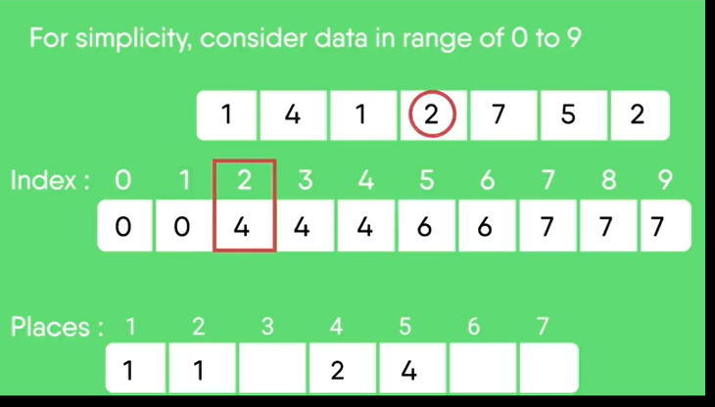

Slide 15
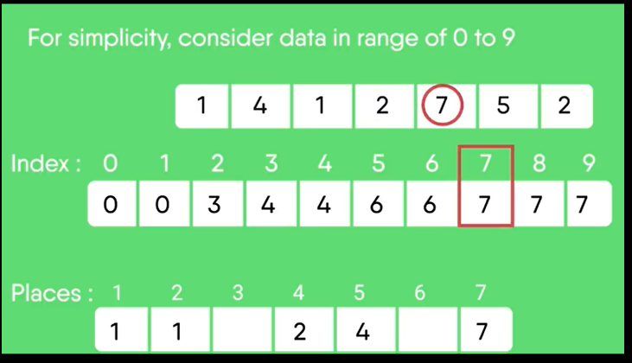

Slide 16
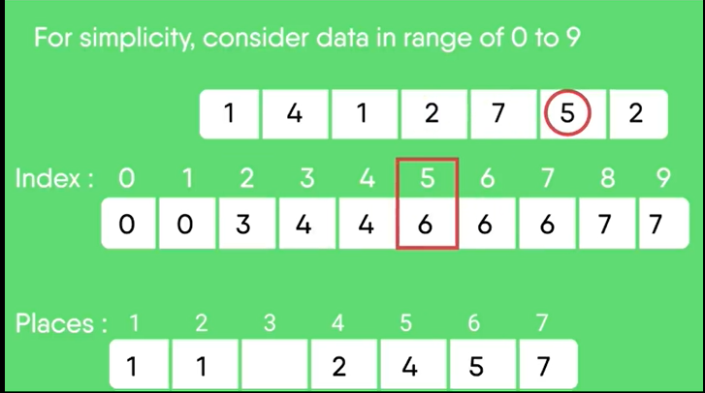

Slide 17
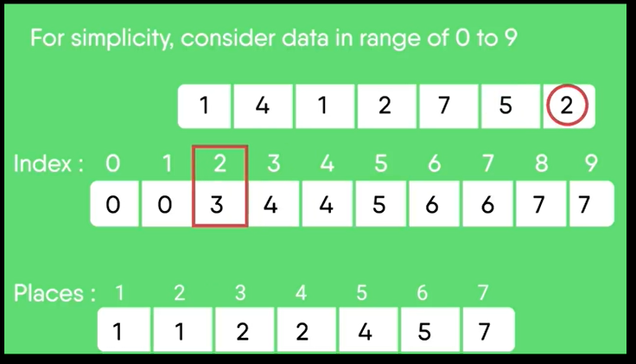
Array is sorted now

Slide 18
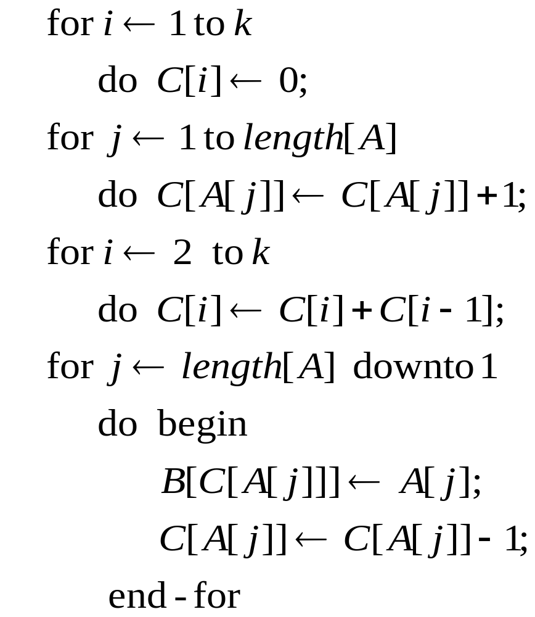



Counting sort (Running Time)

Slide 19
Counting sort is stable.
That is, the same value appear in the output
array in the same order as they do in the
input array.

